Slide 1

Predicting and preventing Accidents and Collisions
Rim Metina-Belknap

Slide 2
Understanding the Data
Background on the data
The dataset can be found here (https://s3.us.cloud-object-storage.appdomain.cloud/cf-courses-data/CognitiveClass/DP0701EN/version-2/Data-Collisions.csv)
To summarize the data
There are 38 attributes
1946733 entries
I analyzed the following variables
Location – Alley, Block, or Intersection
Weather conditions (including road conditions + lighting)
Human factors - Speeding, under the influence, and inattentiveness of drivers

Slide 3
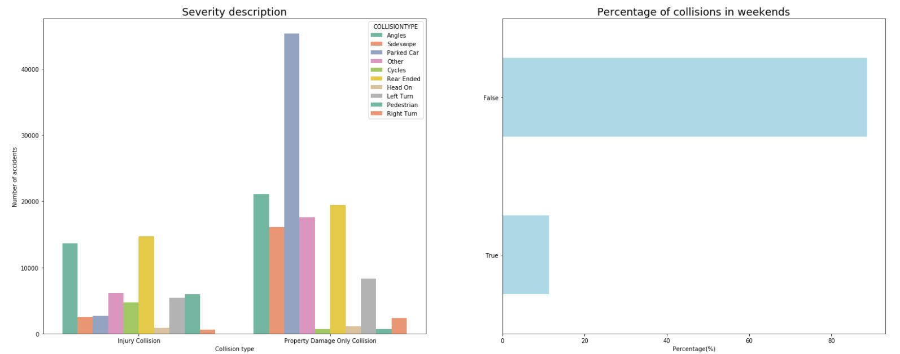
Findings – Collision type and Severity
Observations of the Graph
Parked cars are mostly hit in property damage collisions.
While, major accidents resulting in injury occur due to hitting the rear or pedestrians.
Most collisions occur on weekdays.

Slide 4
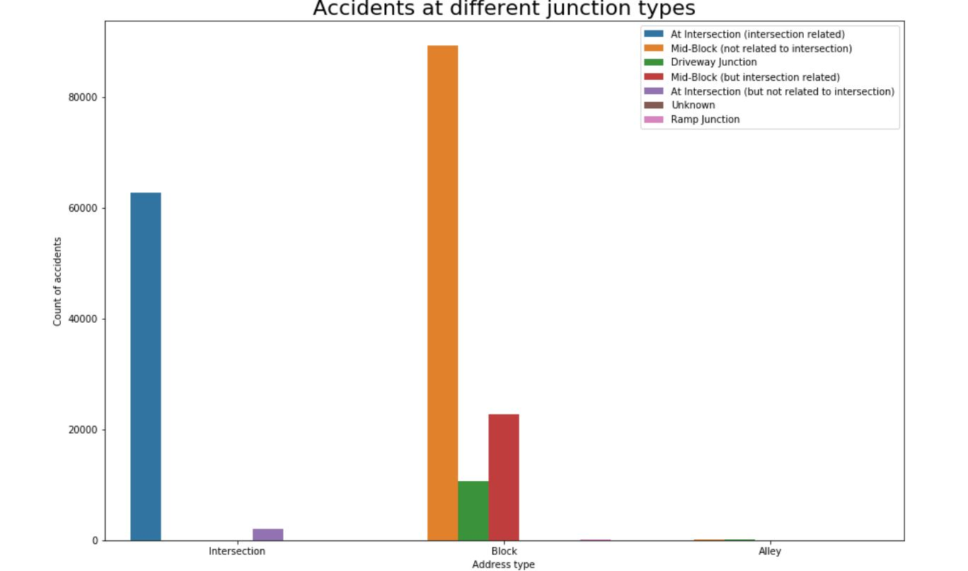
Location
Observations
Few collisions occur in alleys.
More accidents occur midblock, close to intersections.
Some unrelated collisions occur in intersections.

Slide 5
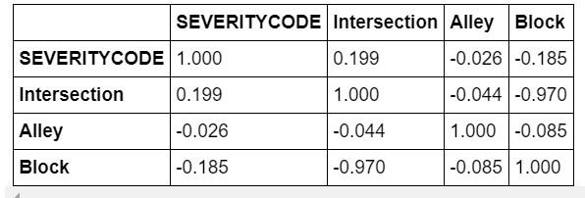
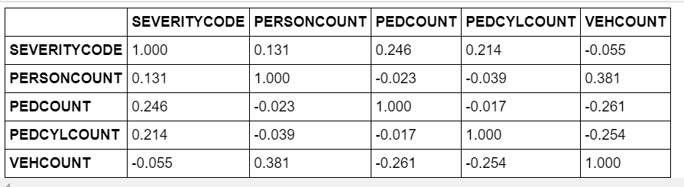
Correlation
Between severity of accident and location
Maximum road accidents occur at intersection
Between severity of accident and those affected
Pedestrians and cyclists are most affected in collisions

Slide 6
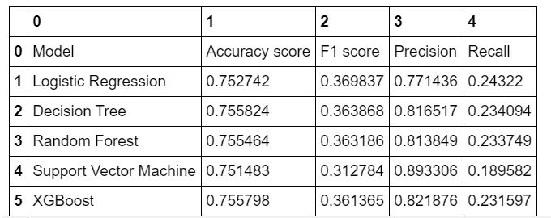
Machine Learning Models

Slide 7
Discussion
Analyzing the dataset, specifically through the data exploration process, there were many observations.
1. Maximum collisions occur at intersections on weekdays
2. Lighting and road conditions have little to no correlation with accidents
3. Weather conditions do not play a significant role
4. Maximum accidents occur in blocks before intersections
5. Being inattentive and being under the influence both cause accidents not one more than the other
6. In property damaged collisions the maximum damage is to parked cars.
In this report, I have highlighted the correlation and relationship between collisions/accidents and human, location attributes, and environmental factors. The observations above identify the main variables that impact collisions. I utilized these observations to classify accidents with machine learning models. Different models predicted collisions using different mechanisms. The model with the most accuracy was the "SVM", as it predicted 89.33% of accidents resulting in injury correctly.
The model created, as well as the data, could be used by the government to limit collisions whether by creating specific signals and signs for pedestrians to cross at intersections, or to warn those on the road to be more cautious at intersections.

Slide 8
Conclusion
To conclude this project and study, the observations above are helpful to understand the relationships between variables and collisions. However, much of the data is unaccounted for, we cannot predict this worldwide without more data. The observations highlighted that human and weather factors did not influence collisions as opposed to location attributes. More data on accidents and collisions in other parts of the world would improve the accuracy of predictions.

